Slide 1
Salary Predictor
Explore Employee Salaries and Job Roles Across Industries

Slide 2
Purpose of the Project
Are you curious about forecasting your upcoming salary?
Are you interested in having a benchmark to guide your negotiation efforts?
The Salary Predictor will help you answer those questions and more!
Follow through to understand how this tool works and how can you use it…

Slide 3
The Dataset
The only way to make good predictions is to have a good Dataset
The one we chose include:
11 columns and 3300 rows
Data from over 70 countries all around the world
Employees job title, experience level, employment type and residence
Information about year, remote ratio and company size
WHERE EVERYTHING BEGINS

Slide 4
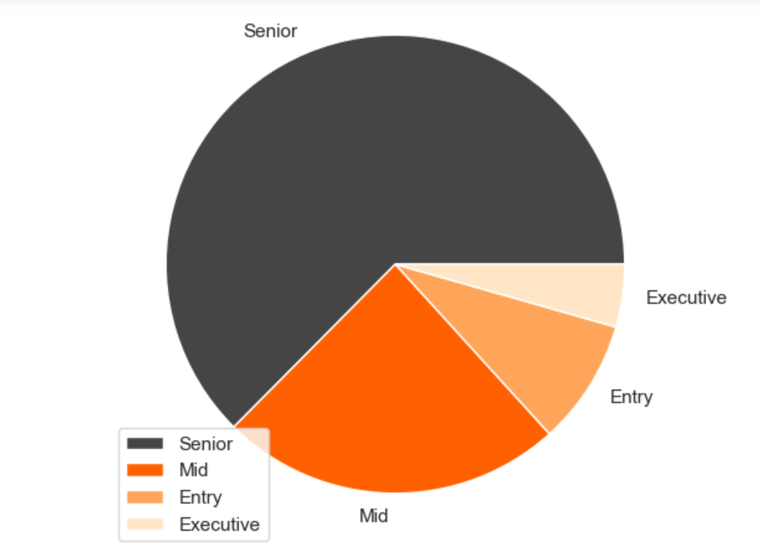
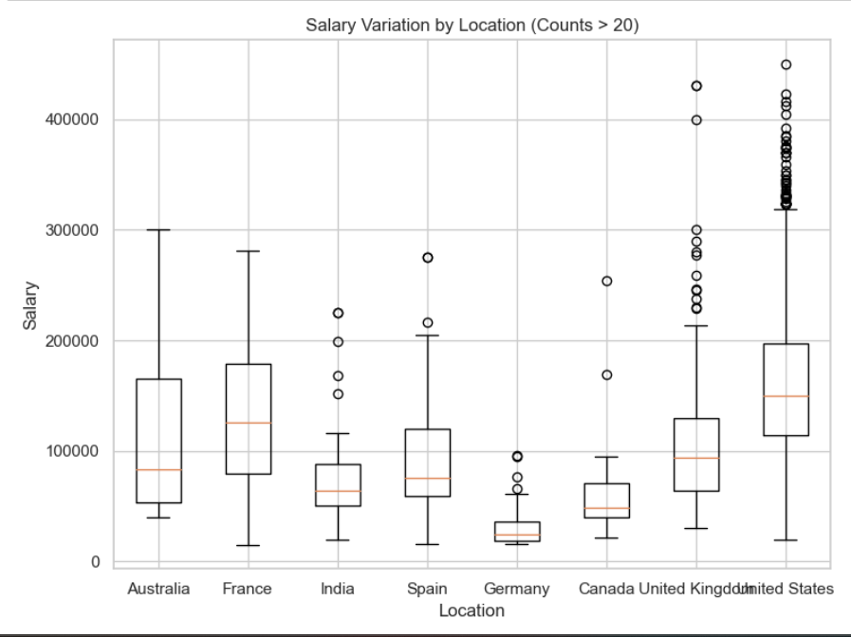
To get accustomed to the data, we did some exploration with Python, plotting among others:
a Pie Chart for Experience Level ratio
a Box Plot to examine Salary Variation across different Locations
Exploratory Data Analysis
Visualizing Salary Distributions
Creation of Predictive Model

Slide 5
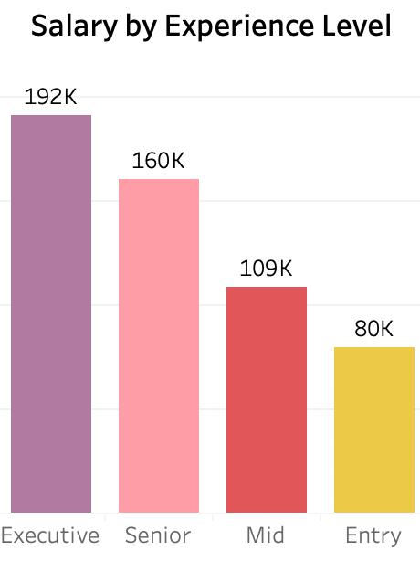
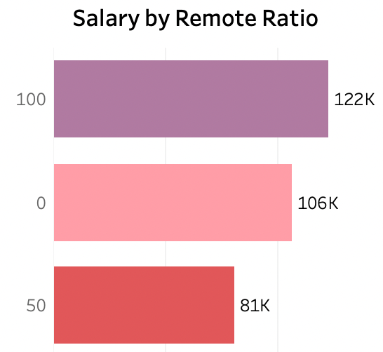
Using Tableau, we examined salary trends relating them to various factors such as employment type, remote work availability, job title, company size, year and experience level.
Exploratory Data Analysis (EDA)
Visualizing Salary Distributions
Creation of Predictive Model
Bar plots: Show salary values by key variables, e.g., experience level, remote location

Slide 6

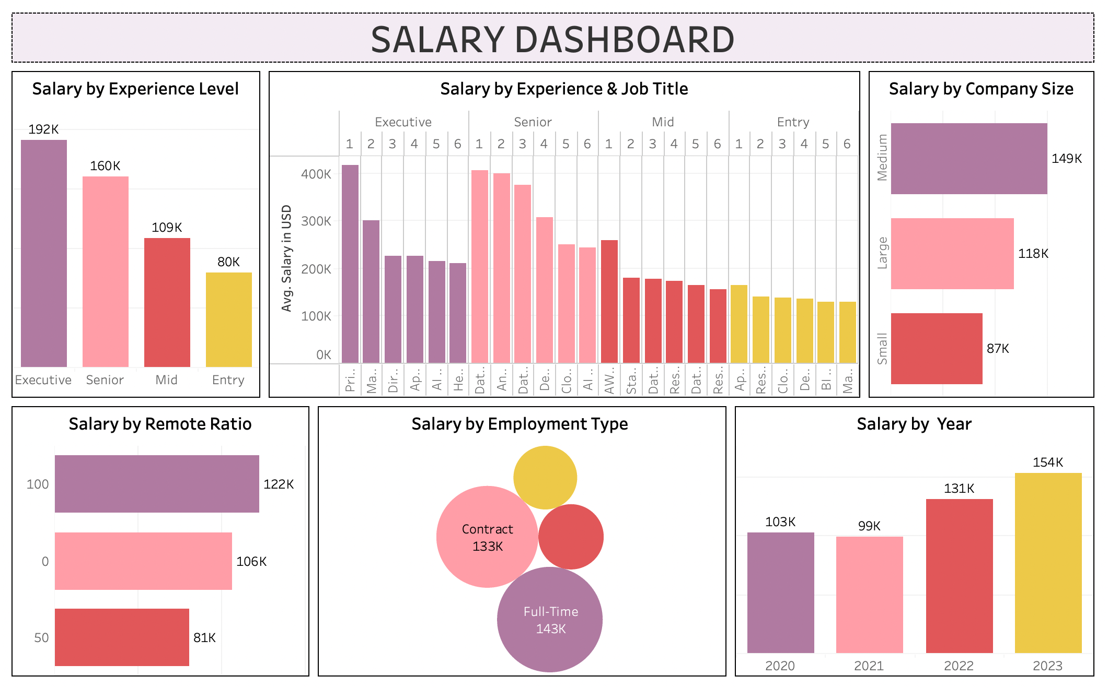

Slide 7
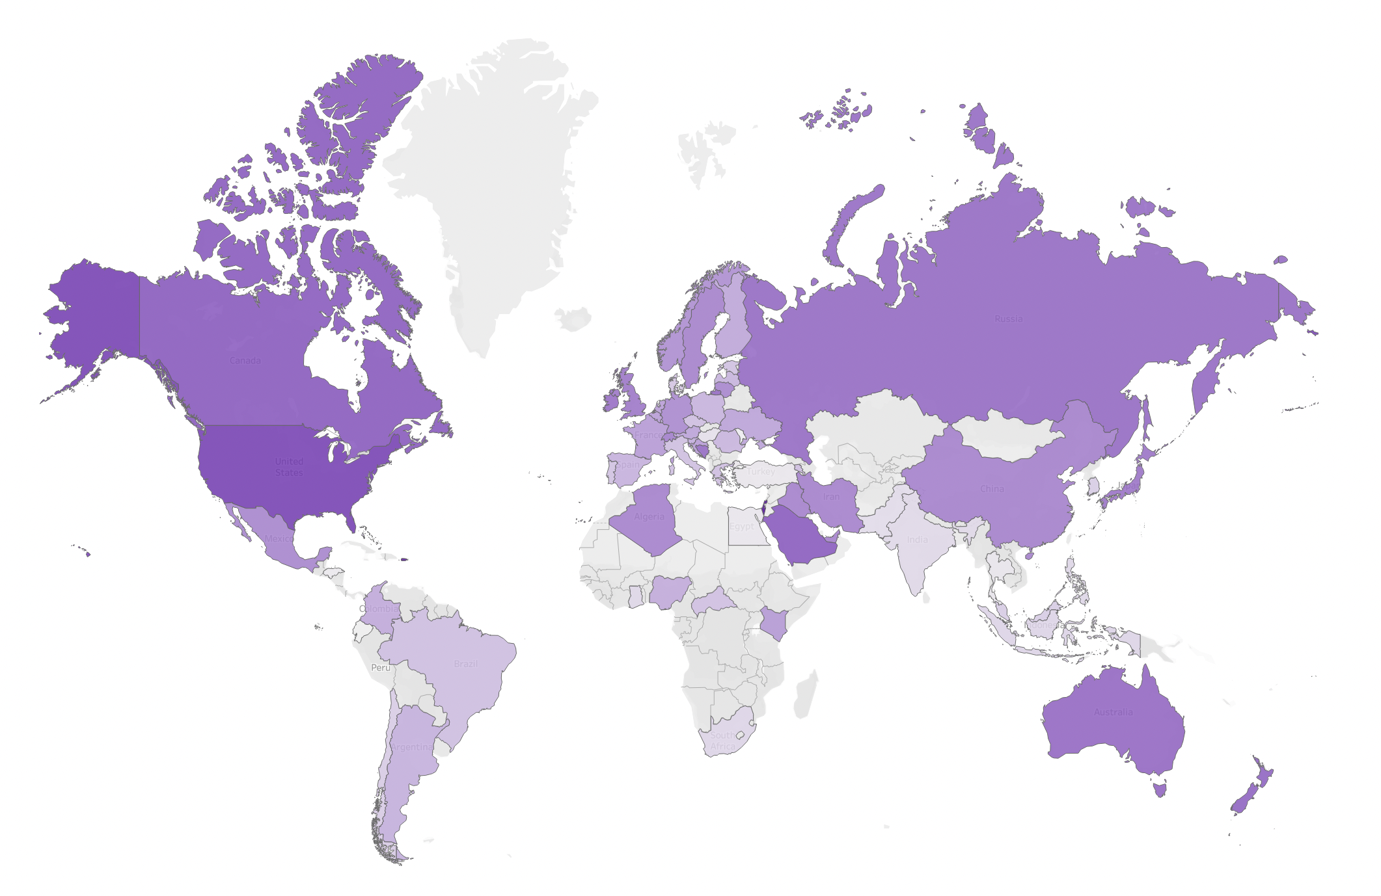
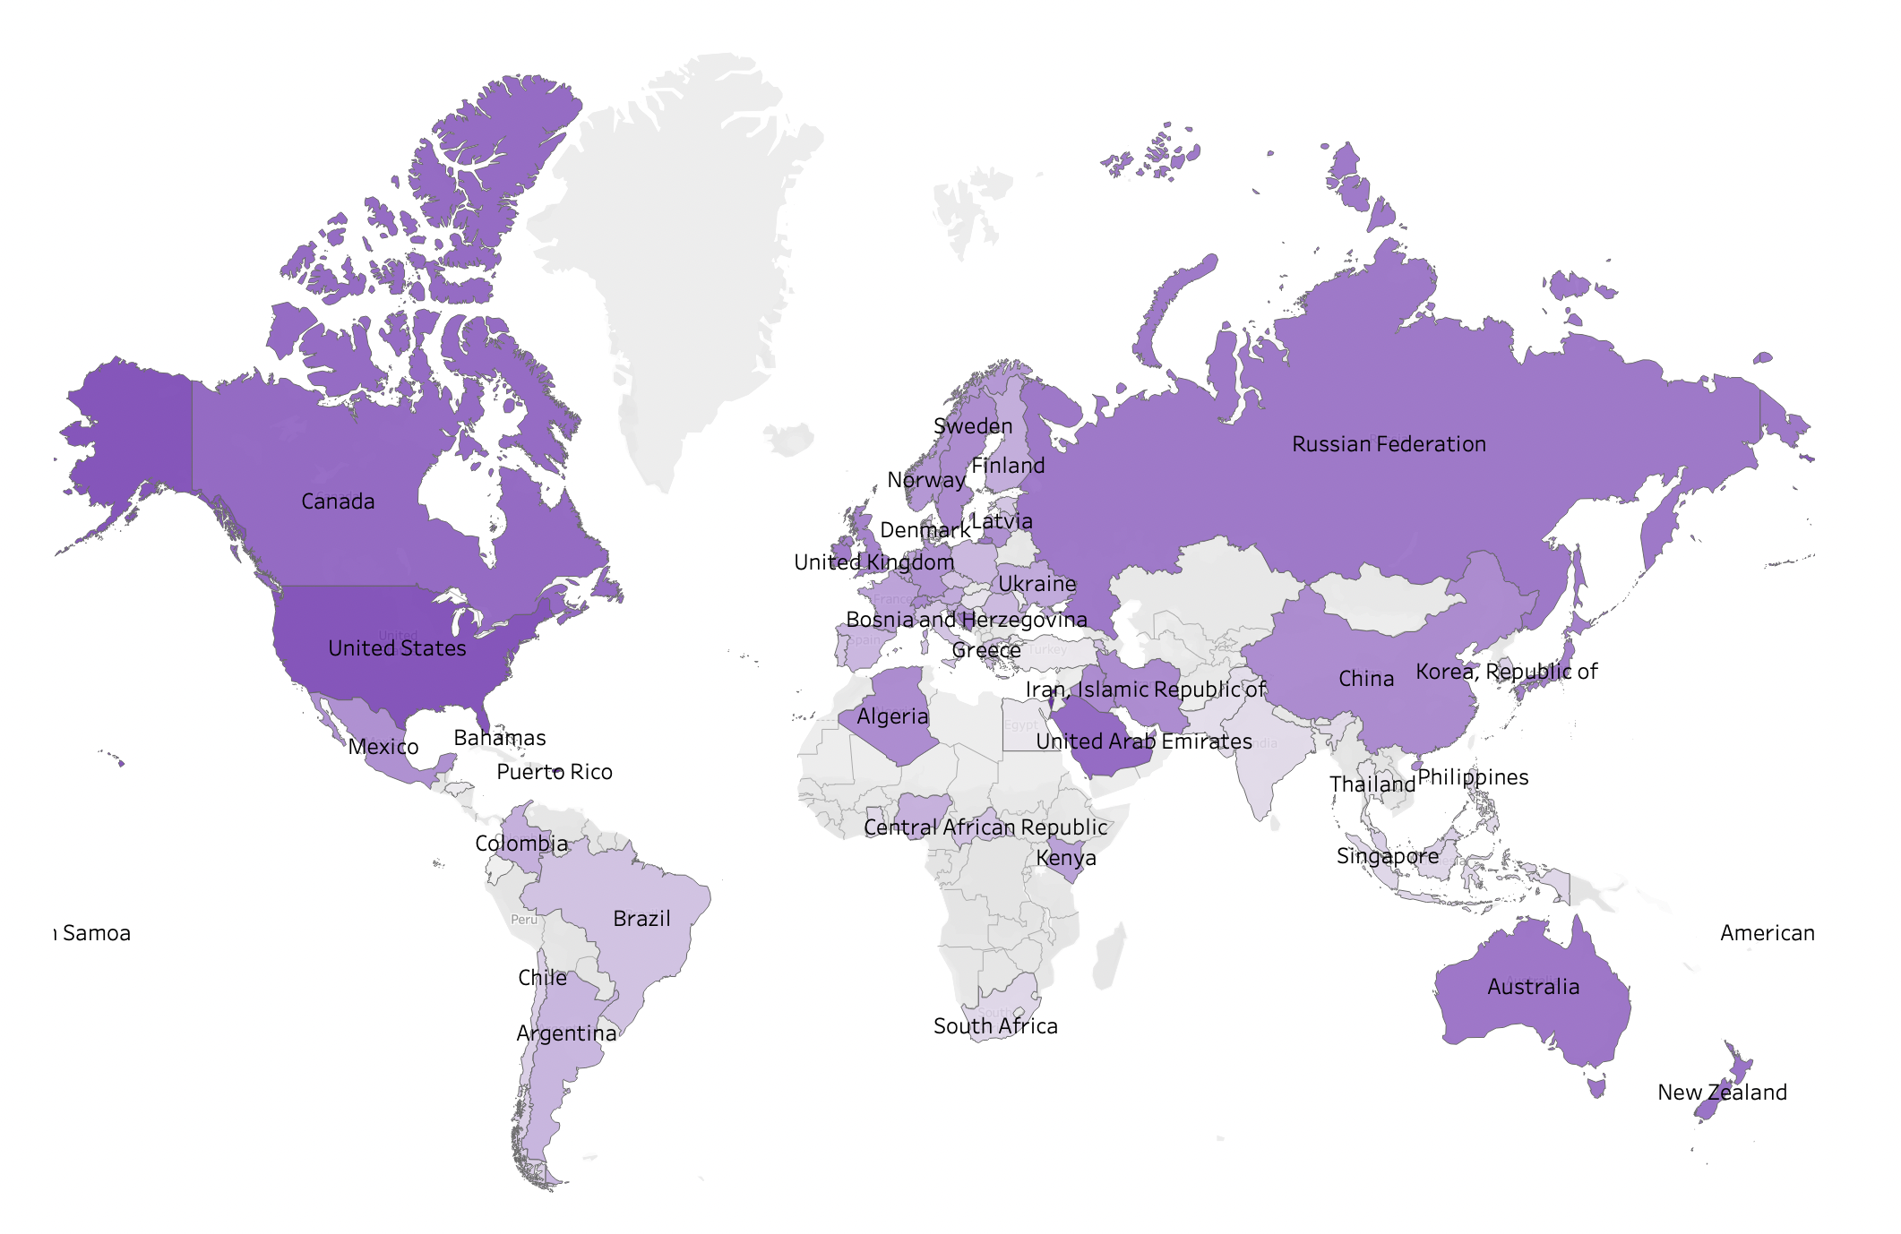
Average Salary
in each Country

Slide 8
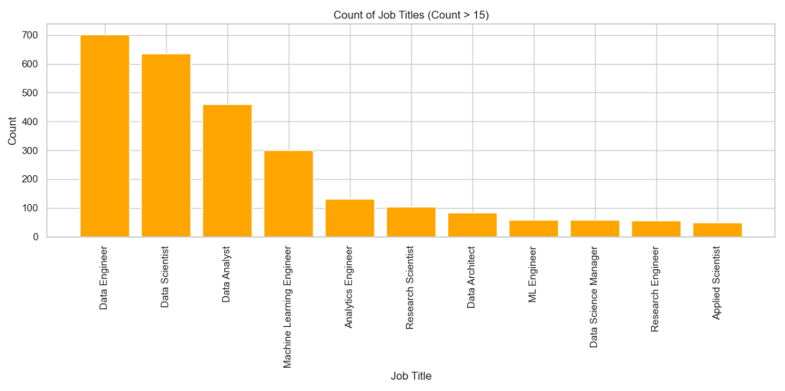
To create the Predictive Model, we could only use columns with a small number of unique values. Given the importance of the Job Title information, we filtered the dataset rows keeping only the 7 most popular ones.
Exploratory Data Analysis (EDA)
Visualizing Salary Distributions
Creation of Predictive Model
At the end we could get our prediction by simply scaling the input data and applying the model !!
model.predict(X_test_scaled)

Slide 9
DEMO
↑ CLICK to predict your salary ↑

Slide 10
THE END
This was Salary Predictor by Babitha & Francesco

